Slide 1
OUTLOOK FOR IMPROVING Plastics CIRCULARITY
Shardul Agrawala
Head, Environment and Economy Integration Division
OECD Environment Directorate
WCEF 2021 – Accelerator Session
Plastics Without Borders
15 September 2021

Slide 2
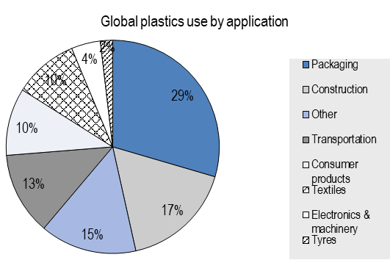
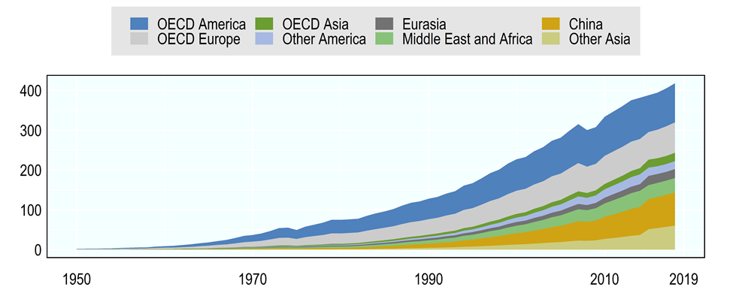
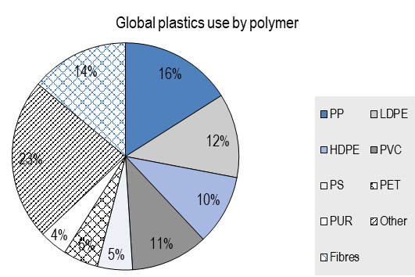
Plastics are characterized by versatile uses and a growing demand
Total plastics consumption (Mt)
OECD Global Plastic Outlook Database 2021
~430 Million Tonnes in 2019

Slide 3
Plastic waste is strongly related to the use of plastics and their lifetime distribution
~325 Million Tonnes in 2019
OECD Global Plastic Outlook Database 2021

Slide 4
Outlook for the Future
Covid-19 had a two pronged impact in 2020
Increases in certain single uses (such as, about 300 kt for PPE in 2020) and the corresponding impact on litter and unsafe disposal
Declines linked to shrinkage of overall economic activity in sectors that are large users of plastics
As economic activity resumes, so will plastic consumption, waste generation and leakage

Slide 5
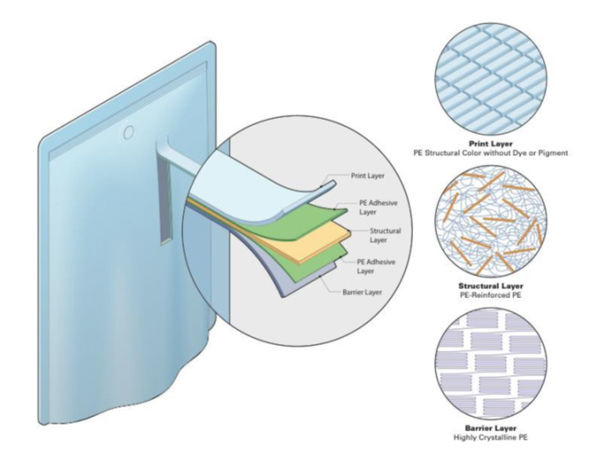
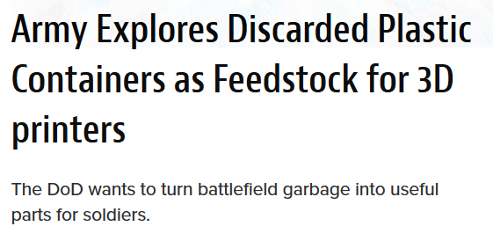
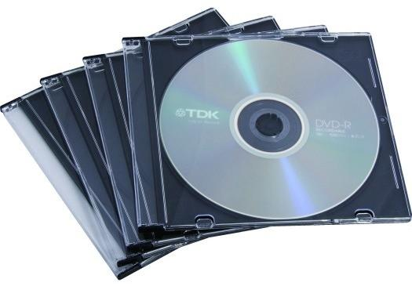
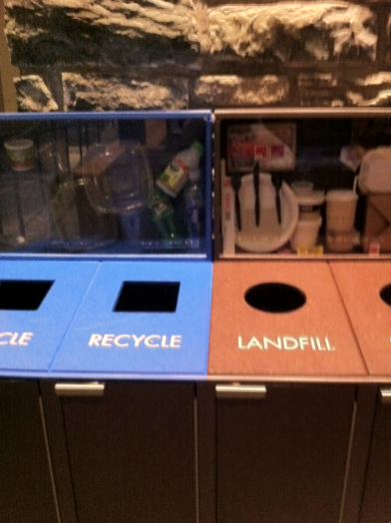
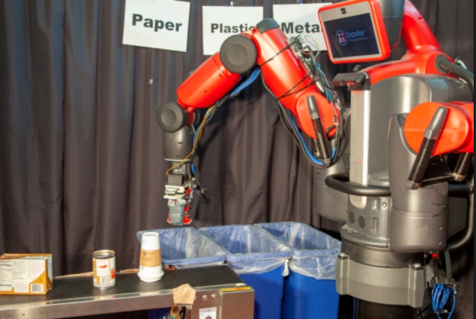
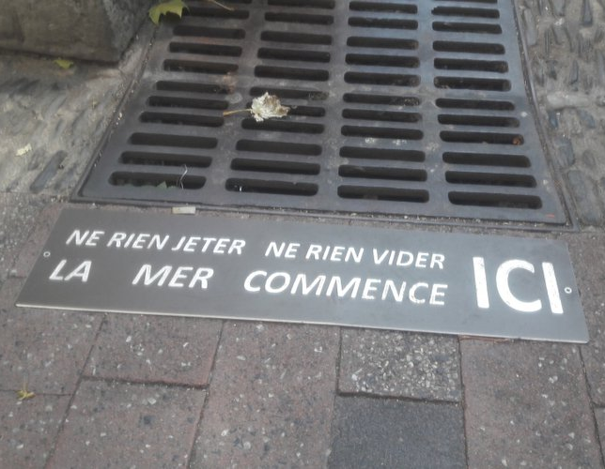
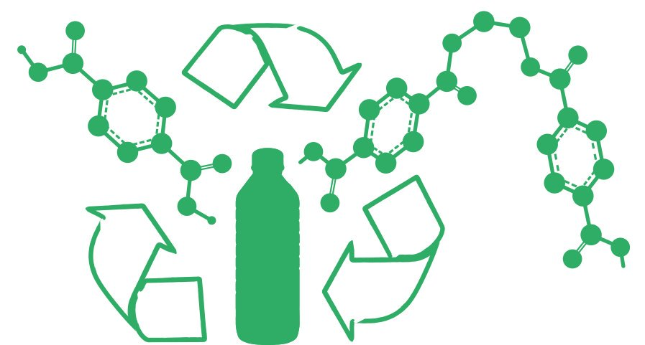
Some positive developments … Innovation
Green Design
Chemical Recycling
Enabling Technologies
3D printing
Plastics
Technologies
IoT
Big Data
Machine Learning
Online Platforms
Cloud Computing
Circular Supply Models
Resource Recovery Models
Product Life Extension
Sharing Models
Product Service System Models
Digitalization
Behaviour Innovations
New Business Models
POLICY
Process Innovation
Behavioural Nudges
Information Campaigns
Source: MachineDesign
Source: Jason Dorfman, MIT CSAIL
Source: re3d.org
Source: Spotify
Source: Beckman 2018
Source: nudges.org

Slide 6
Some positive developments - policies
International action to combat marine plastic litter via the G7 and the G20
Bans and taxes on frequently littered plastic products, implemented by more than 120 countries (but target less than 1% of plastic volumes)
Steering policy instruments with direct incentives to better design plastic products, to sort and recycle plastic waste (but generally cover few products and a small share of the world population)

Slide 7
Scaling plastic circularity across borders
Restrain consumption and optimise design
Plastic taxes, EPR fee modulation, regulating hazardous chemicals
Improve cross-border traceability
Tracking and reporting of scrap and secondary production
Hazardous chemicals in plastic value chains
Fix global markets for secondary plastics
Disincentivise virgin plastics
Create a differentiated demand for recycled plastics
Ensure that the proliferation of standards (e.g. recyclability, reparability, recycled content, material content), do not inhibit plastic circularity across borders

Slide 8
Thank You
shardul.agrawala@oecd.org

